Slide 1
Scientific journals and articles:
So much to read; so little time.
So, what are we looking for?
Today:
Scientific journals
The art of the title
Readings

Slide 2
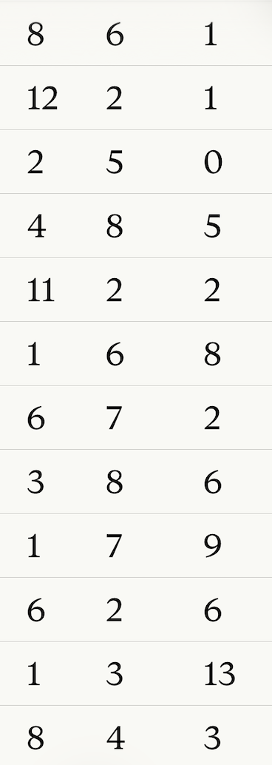
Would you read this journal:
Journal title Yes Maybe Not Likely
Marine Biology
Freshwater Biology
Animal Behaviour
Ecological Modeling
Ecology
Molecular Ecology
Journal of Fish Biology
Journal of Crustacean Biology
Journal of Fish Diseases
Science
Canadian Journal of Zoology
Canadian Journal of Fisheries
and Aquatic Sciences

Slide 3
Journals in which SAFS faculty published in 2002–2012
2002-2012 |  | 2013-2023
Canadian Journal of Fisheries and Aquatic Sciences | 85 | Fish Res | 121
Transactions of the American Fisheries Society | 56 | ICES J Mar Sci | 113
Fisheries Research | 38 | Can J Fish Aquat Sci | 100
ICES Journal of Marine Science | 32 | PLOS ONE | 76
Marine Ecology Progress Series | 31 | Fish and Fisheries | 68
Ecology | 23 | Mar Ecol Prog Ser | 65
Journal of Cetacean Research and Management | 23 | Trans Am Fish Soc | 49
Copeia | 21 | Proc Nat Acad Sci | 46
Ecological Applications | 19 | Ecol Appl | 36
Fish and Fisheries | 19 | Ecol Evol | 36
Journal of Fish Biology | 19 | Front. Mar. Sci. | 34
North Pacific Anadromous Fish Commission Bulletin | 19 | Ecology | 31
Fisheries Oceanography | 18 | Ecosphere | 31
Fisheries | 18 | Deep-Sea Res Part II | 28
Proceedings of the National Academy of Sciences | 18 | Mol Ecol | 27
Fishery Bulletin | 17 | Glob Change Biol | 26
Marine and Freshwater Research | 17 | N Am J Fish Mgmt | 25
North American Journal of Fisheries Management | 15 | J Appl Ecol | 24
Conservation Biology | 14 | Mar Policy | 24
Freshwater Biology | 14 | Sci Rep | 24
Ecosystems | 13 | Environ Biol Fish | 23
Limnology and Oceanography | 13 | Science | 23
Ecological Modeling | 12 | Ecol Model | 22
Science | 12 | Proc R Soc Lond B | 22

Slide 4
The art of the title
Or, you never get a second chance to make a first impression.

Slide 5
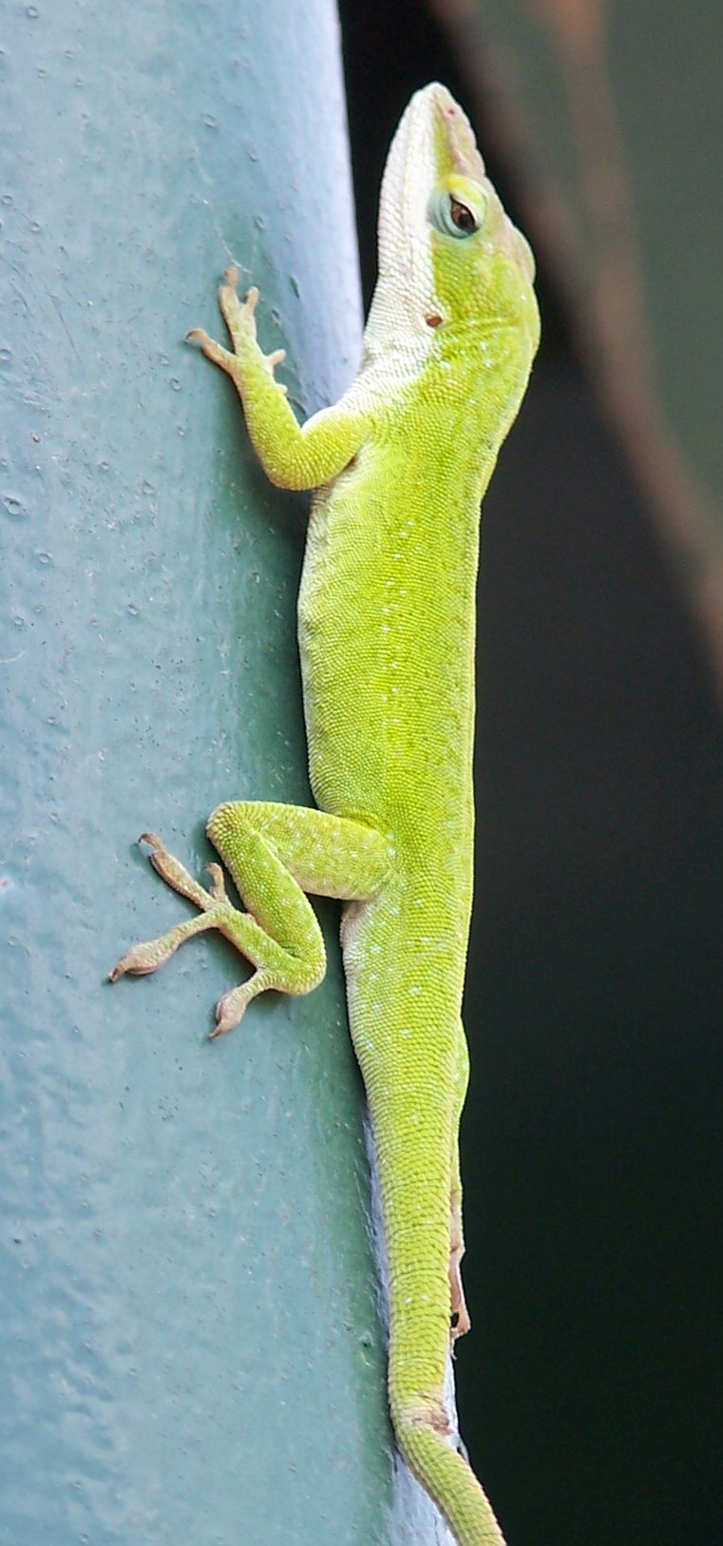
The art of the title
Imagine you do a study on anole biogeography. What is your title going to be?

Slide 6
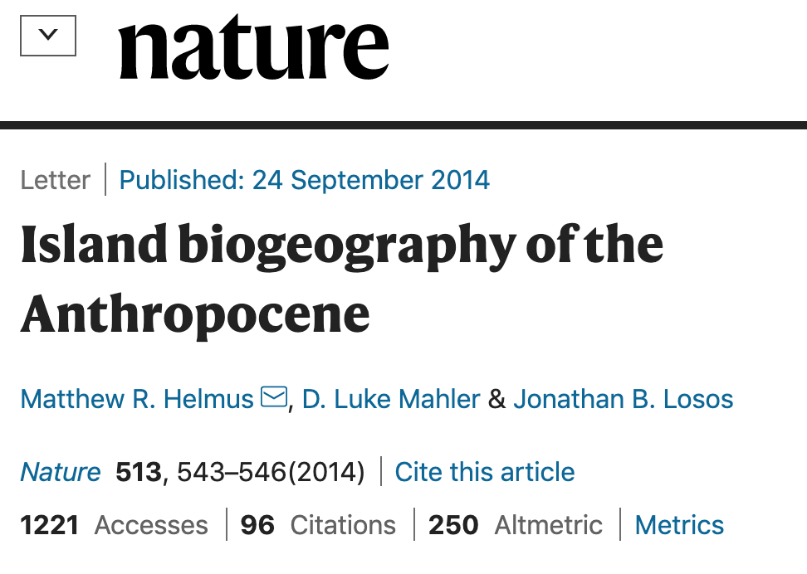
The art of the title
Imagine you do a study on anole biogeography. What is your title going to be?

Slide 7

The art of the title
Imagine you do a study on anole biogeography. What is your title going to be?

Slide 8
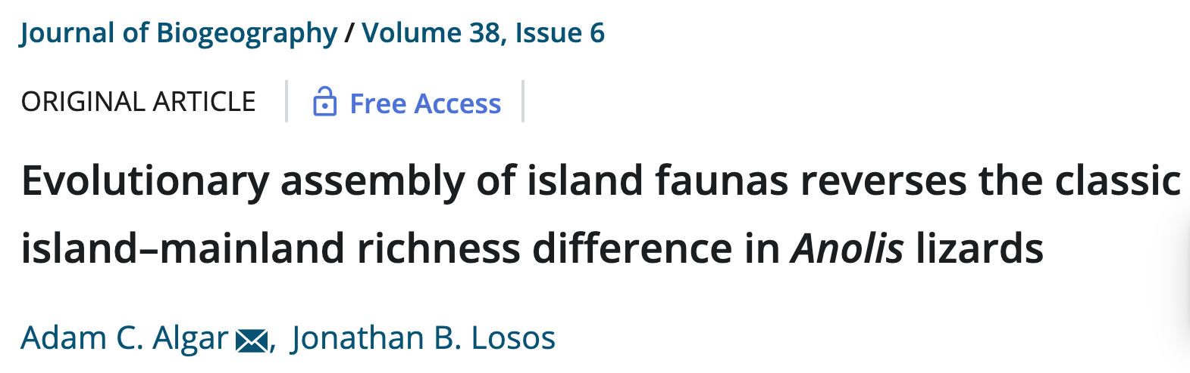
The art of the title
Imagine you do a study on anole biogeography. What is your title going to be?

Slide 9
Class activity:
Let’s now go on-line to the UW library, find a journal, open the table of contents, and look at it. We will use the Canadian Journal of Fisheries and Aquatic Sciences as an example.
http://catalog.lib.washington.edu/search~

Slide 10
Let’s look at the most recent issue of the journal and scan the titles. Which would you choose to read, and why? Do some words in the titles intrigue you or turn you off?
Are you looking for reference to a place such as “Alaska” or an organism such as “octopus” or a theme such as “conservation” or a discipline such as “genetics”?

Slide 11
3. The art of the title
The unspoken rules of the title:
Don’t underestimate the power that your title can have
Tailor the title to your audience, which may be dictated by the choice of journal
Too broad, and you risk disappointing people
Too narrow, and you risk selling yourself short
When in doubt, use a title that tells the main message
Many people will only read the title.
What would you want those people to know?

Slide 12
Assignments for today and Wednesday:
1. Choose a single journal article that speaks to you in some way. It does not have to be on the same topic as your project. This choice is very important. You will read that article closely, write about it, tease it apart, present it to the class, and in other ways make it a focal part of your experience in this course. It will be the basis of your poster later in the course. We will continue looking in class on Wednesday.

